Slide 1
Physics for Scientists and Engineers with Modern Physics
Bo Qiao
Associate Professor
Key Laboratory of Luminescence and Optical Information (Beijing Jiaotong University), Ministry of Education，Beijing 100044，China
Institute of Optoelectronics Technology, Beijing Jiaotong University, Beijing 100044，China
2023, Spring

Slide 2





About me…
+86 130 5100 2020
boqiao@bjtu.edu.cn
http://faculty.bjtu.edu.cn/sci/9198.html
Room 119, Building 1, Beijing Jiaotong University,
Beijing, China

Slide 3
Hey!
You are about to begin what could be one the most exciting course that you will undertake in university. It offers you the opportunity to learn what makes our world “tick” and to gain insight into the role physics plays in our everyday lives.

Slide 4
Feature of text book
(1) True style of U.S.University — pay attention to pick interest and motivate desire to read book:
(2) The best way to promote your ability of expression in English by reading original edition of English book.
“We will see many examples in this book of how physics is useful in other fields, an in everyday life.”

Slide 5
Chapter 1. Introduction
Measurement
Vector
Dimensions

Slide 6
1-1 Observation & Measurement
Physics is based on measurement of physical quantities.
We measure each physical quantity in its own units by comparison with a standard.
There are so many physical quantities that it is a problem to organize them. Fortunately, they are not all independent （独立）.
Base standards must be invariable, precision and accessible（恒定，精确，容易取得的）.

Slide 7
1-2 The International System of Units
In 1971, the 14th General Conference on Weights and Measures, The SI (International System) was adopted.
It is based on meter, second and kilogram.
Meter, kilogram and second are basic units.
Many SI derived units are defined in terms of these base units, such as:
1 watt = 1 W = 1 kg ·m² / s³
They are so called derived units.
Note：
没有单位的结果是没有意义的！

Slide 8
Unit prefixes (P7)
In the metric (SI) system, the larger and smaller units are defined in multiples of 10 from standard unit, and this makes calculation particularly easy.
You may pay attention to the case of letters. Upper case and lower case mean quite different things.
1 MeV = 1×10⁶ eV
1 meV = 1 × 10⁻³ eV
There is a factor of 10⁹ between the two!

Slide 9
Metric (SI) prefixes (P7)
exa E 10¹⁸
peta P 10¹⁵
tera T 10¹²
giga G 10⁹
mega M 10⁶
kilo k 10³
hecto h 10²
deca da 10¹
deci d 10⁻¹
centi c 10⁻²
milli m 10⁻³
micro μ 10⁻⁶
nano n 10⁻⁹
pico p 10⁻¹²
femto f 10⁻¹⁵
atto a 10⁻¹⁸

Slide 10
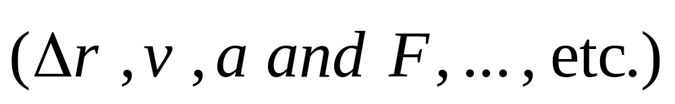
1-3 Vectors and Scalars
(P44)
Vector:
A quantity has direction as well as magnitude, such as displacement, velocity, acceleration, force, … , etc.
Scalar:
A quantity is specified completely by giving a number and units (no direction), such as mass, time, energy, … etc.
Some scalars are always positive, whereas others such as electric charge can be positive or negative.
Vectors follow certain vector rules of combination.

Slide 11
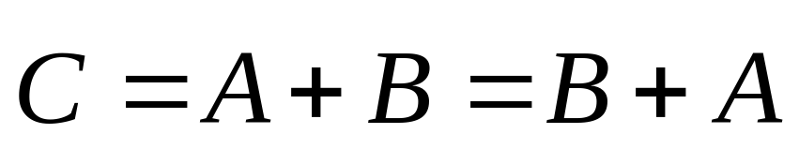
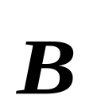
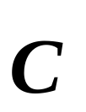
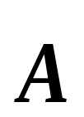
Adding vectors graphically
----commutative law for vector sum
The vector sum is the vector that extends from the tail of one vector to the head of the other vector------tail-to tip method of adding vectors.

Slide 12
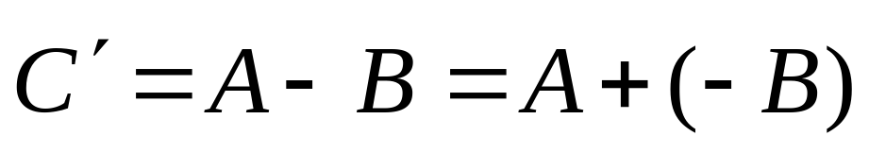
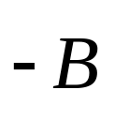

Subtracting vectors graphically
❒
C
′
❒
C
′
The difference between two vectors is the vector that extends from the head of the 2nd vector to the head of the 1st vector.

Slide 13
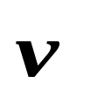
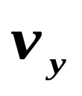

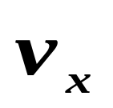


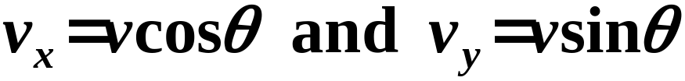
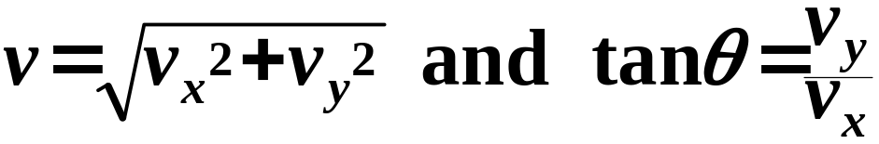
Components of vectors
y
A component of a vector is the projection of the
vector on an axis. This component may be in two
or three dimensional coordinate system.
o
x
v
❒
❒
❒
is resolved to and ,
y
v
=
v
i
+
v
j
x
y
Both pairs of values contain the same information.

Slide 14
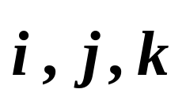
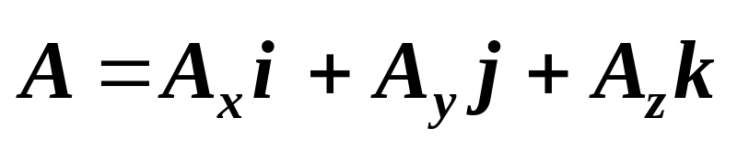
Unit vectors
An advantage of using vector components is that complicated vector problems can be replaced by algebraic manipulation.
For a fixed Cartesian system, unit vectors:
—— unit magnitude, only indicate directions
In the coordinate system,
Coordinate system can be chosen freely.

Slide 15
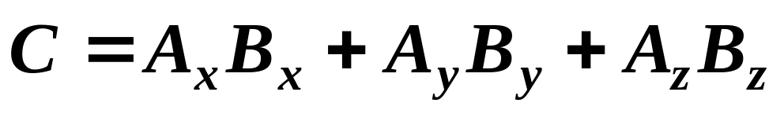
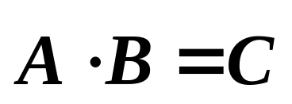
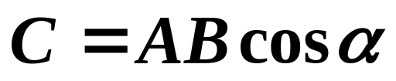
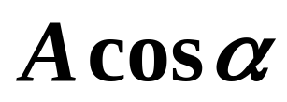
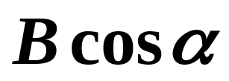

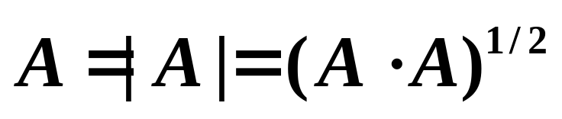
Multiplying a vector by a vector
(1) The scalar (dot) product
α
α
The magnitude of :

Slide 16
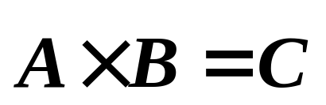
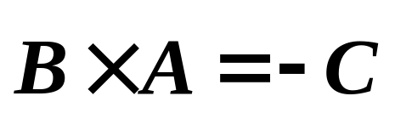

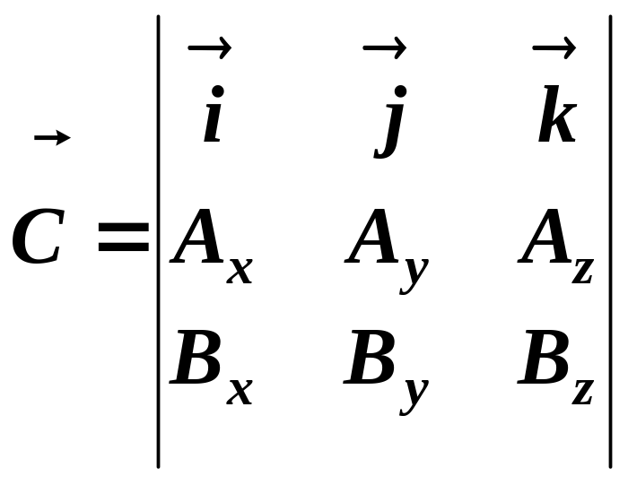
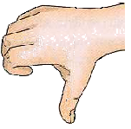
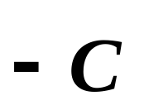
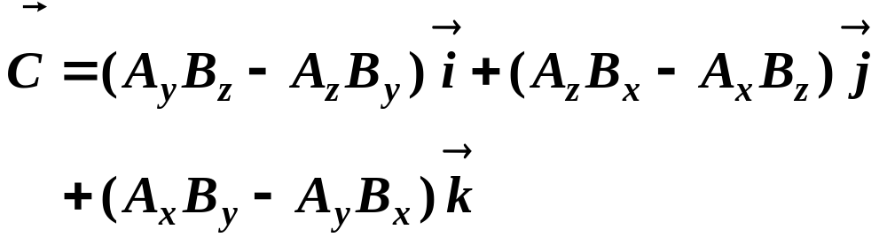
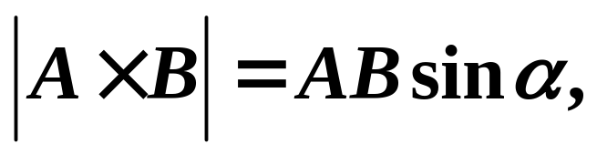
(2) The vector (cross) product
α
direction is as the figure showing.

Slide 17
1-4 Dimensional Analysis
(P11)
When we speak of the dimensions of a quantity, we are referring to the type of units or base quantities that make it up.
All measurements reduce ultimately to the measure-ments of length, time and mass in mechanics. Length, time and mass specify the three primary dimensions（基本量纲）. [L] [T] [M]
The dimension of a physical quantity is the algebraic combination （代数和）of [L], [T] and [M] from which the quantity is formed.
[v] = [L/T] or [LT⁻¹]

Slide 18
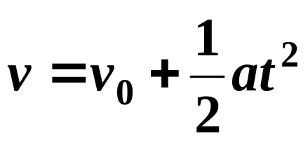
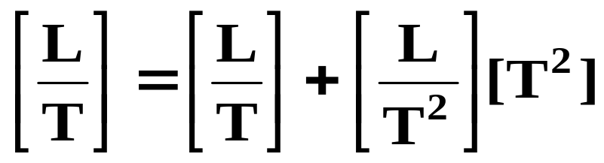
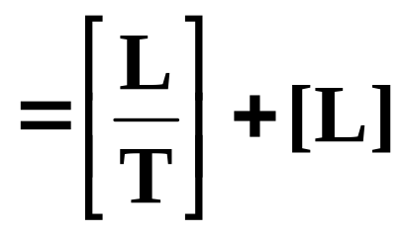
Dimensions can be used as a help in working out relationships, and such a procedure is referred to as dimensional analysis.
The dimensions on both sides of an equation must be equal.
e.g. If we write an equation as
?
?
The dimensions are incorrect. Thus we conclude that there must be some errors in the above Eq.

Slide 19
Summary
1. Any physical quantity has dimensions that are algebraic combinations of the primary dimensions [ L^{q}T^{r}M^{s}], where q, r, s can be positive, negative integer or fractional powers.
That is,
dimQ = [Q ]= [L^{q}T^{r}M^{s}]
2. Dimension is not unit（量纲非单位）.
3. Dimension analysis: check the correctness of physical equation.
4. Special case: dimensionless.

Slide 20
The problems of chapter 1:
36, 37, 38

